Slide 1

Presentation on
Simulation of Home Appliances using Android App and Google Assistant.
Submitted By-
Abhay Pratap Srivastava -1784110002
Arun Kumar -1784110017
Bhanu Pratap Yadav -1784110023
Rahul Gupta -1784110037
Under Guidance of
Dr. Anurag Sewak

Slide 2
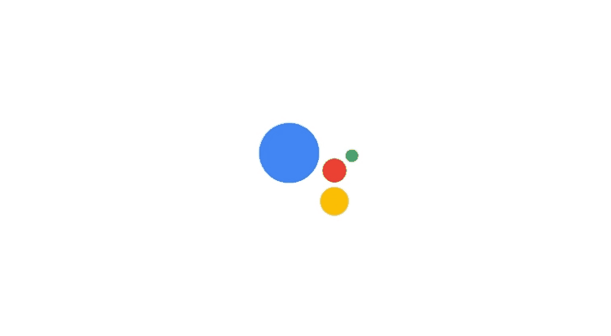
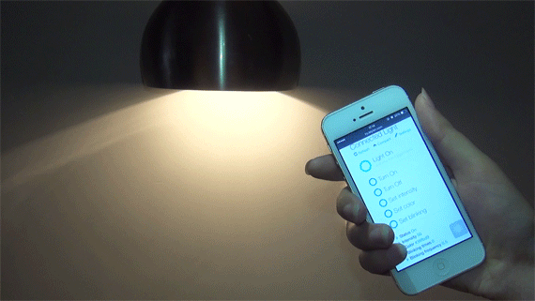
Objectives of Project
The main objective of this project is to design and simulate a prototype of a home automation devices controllable from an Android mobile application and Google Assistant.

Slide 3
System Overview
USER REQUEST
Android App
Google Assistant
This is how project is approached. One for Android App and Other for Google Assistant.
Arduino UNO R3
Feed on Adafruit
Applet on IFTTT
Relay Board
Simulation on Adafruit.io
LED Lights
Lamp
Fan

Slide 4
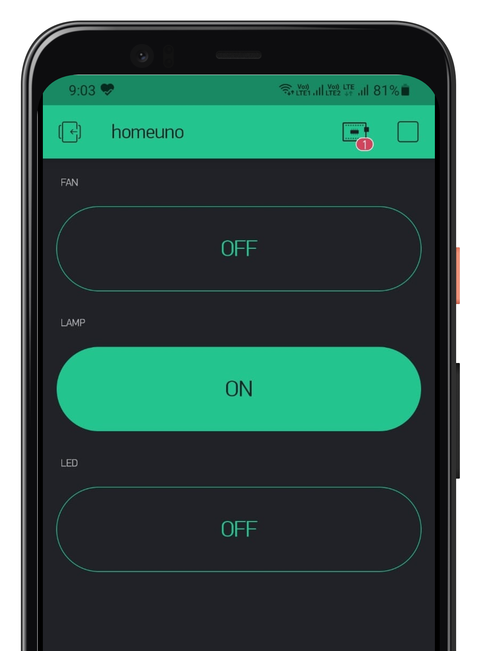
Control using Android App
Software/App used:
Proteus 8 Professional
Arduino IDE
VSPE
Blynk IoT

Slide 5


1. Proteus 8 Professional
Proteus 8 is one of the tools needed for circuit design and simulation. This software is developed by Labcenter Electronics.
2. Arduino IDE
The Arduino Integrated Development Environment (IDE) is a cross-platform application that is written in functions from C and C++. It is used to write and upload programs to Arduino compatible boards.

Slide 6
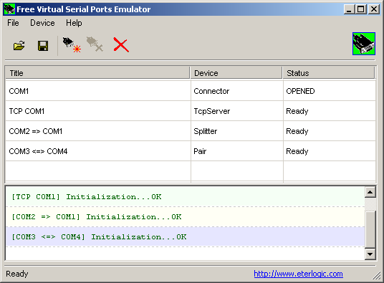

3. VSPE
The Virtual Serial Port Emulator or VSPE is a program that allows us to create, test, and debug applications that use the parallel port.
It allows the creation of virtual devices to send and receive data.
4. Blynk IoT
Blynk is a Platform which provides a platform for building mobile applications that can connect electronic devices to the Internet and remotely monitor and control these devices.

Slide 7
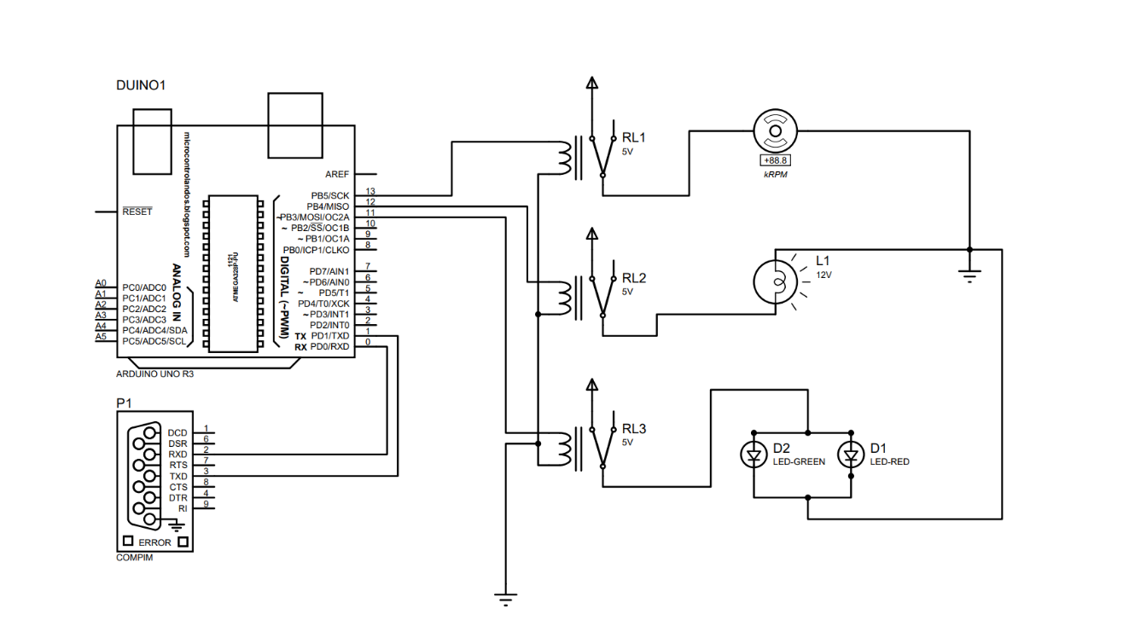
Components used in Circuit
Designed in Proteus 8
Arduino UNO R3
COMPIM
Relay Module
LED, Lamp, Fan
Circuit Diagram

Slide 8
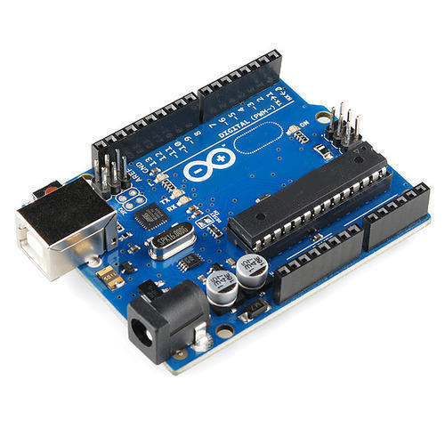
Arduino UNO R3
The Arduino Uno is a microcontroller board based on the ATmega328. It has 20 digital input/output, an in-circuit system programming (ICSP) header, and a reset button.

Slide 9
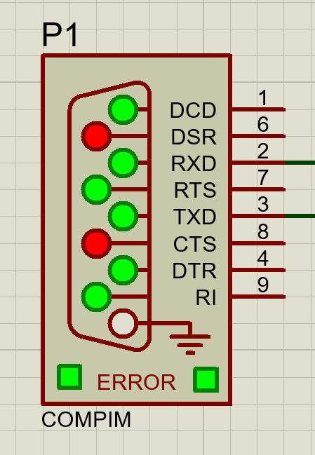
2. COMPIM
Provide option for Virtual serial ports.
On which port communication is to be made can be selected.
Also the virtual baud rate (on which rate communication or data to be transmitted) is selected.

Slide 10
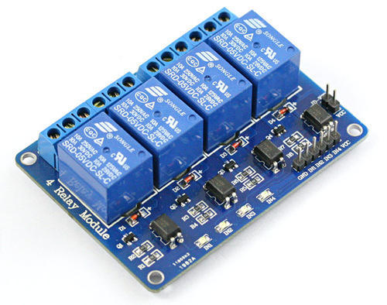
3. Relay Module
A power relay module is an electrical switch that is operated by an electromagnet.
The electromagnet is activated by a separate low-power signal from a micro controller.
When activated, the electromagnet pulls to either open or close an electrical circuit.

Slide 11
Circuit in Proteus

Slide 12
Android App Configuration
Created an account on Blynk IoT App
Authentication Token Sent on Email
Tap on
CREATE PROJECT.
Enter Project Name, Board and Connection Type
App Successfully configured.
Publish on Play Store or use in same app.
Create Switch for all three devices- Lamp, Light and Fan
Select Button in Widget Box.
Configure PIN for each device, select Button Type- Switch and 0- Off, 1- ON

Slide 13
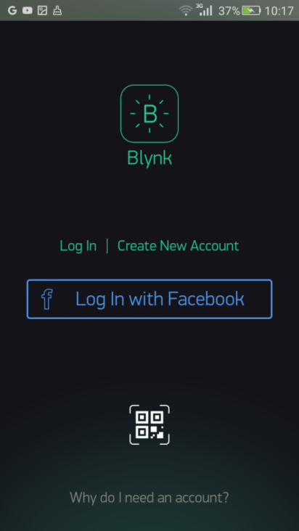
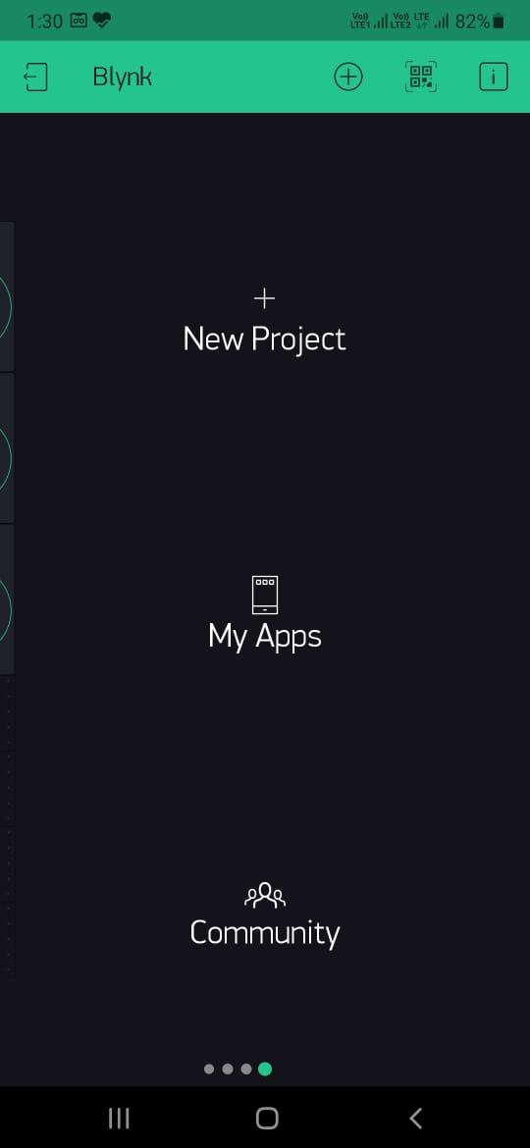
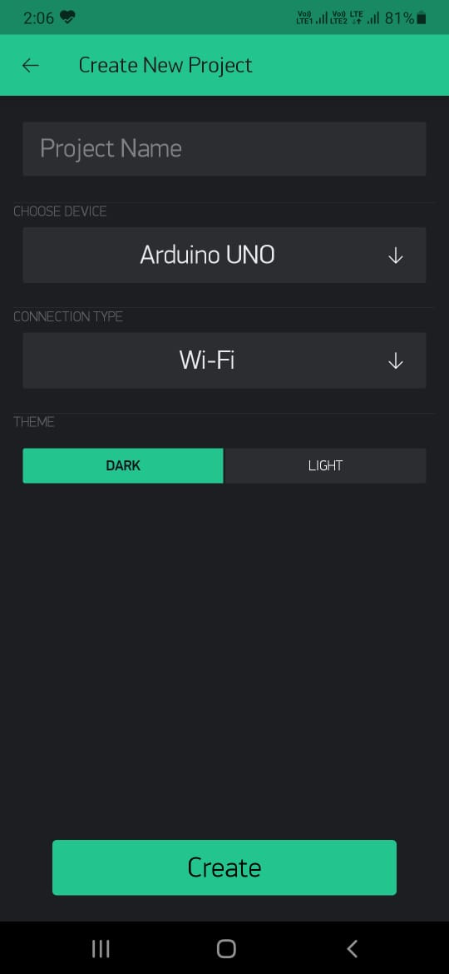
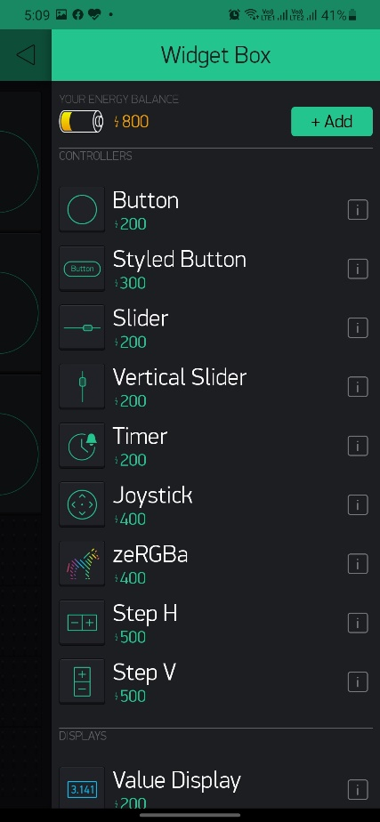
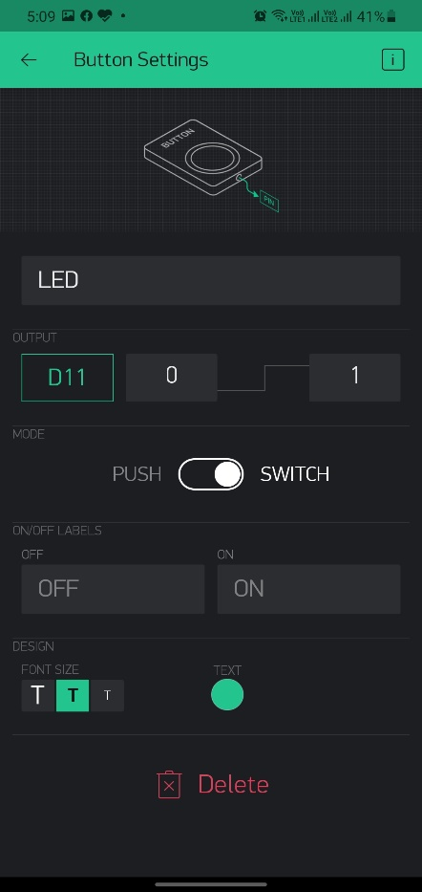
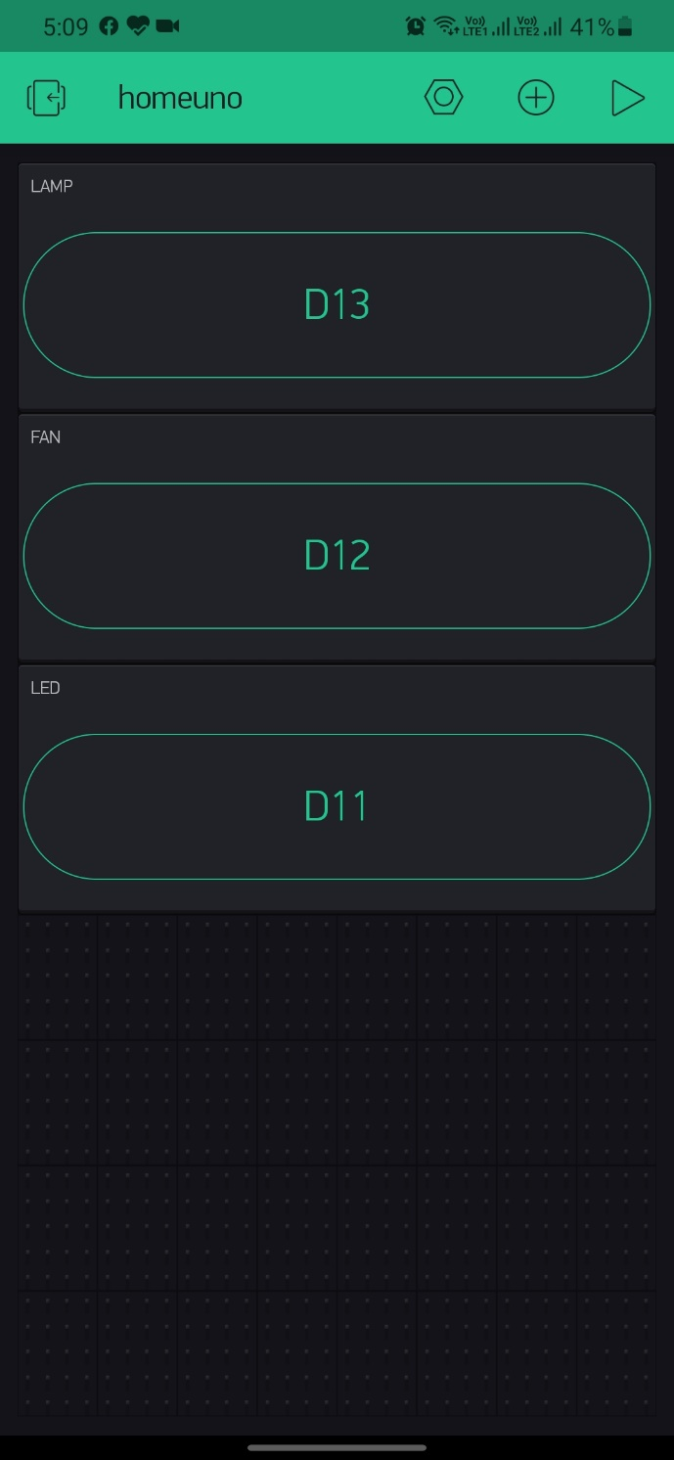
Screenshots

Slide 14
Working Steps after App Setup
CODE/Program for appliances in Arduino IDE
Paste Generated Hex File Path in ARDUNO UNO Program path
Set up virtual Serial Port at COM2 to send/receive signal using COMPIM
Run Blynk-Ser Script to send and receive signal and operate using App
Pair COM2 ⬄ COM1 using VSPE
Blynk Library by default send/receive
signal at Port 1

Slide 15
Arduino IDE Code – Arduino UNO Program
Install Library Blynk IoT, Select Board, Enable Compilation, Paste URL to use Third party hardware
Copy authentication/Token code sent by Blynk on email.
Include Library BlynkSimpleStream.h
And also authentication code in program
Paste this path in Arduino UNO R3 program path in Proteus 8
Copy Generate HEX file path
Write Program and Compile

Slide 16
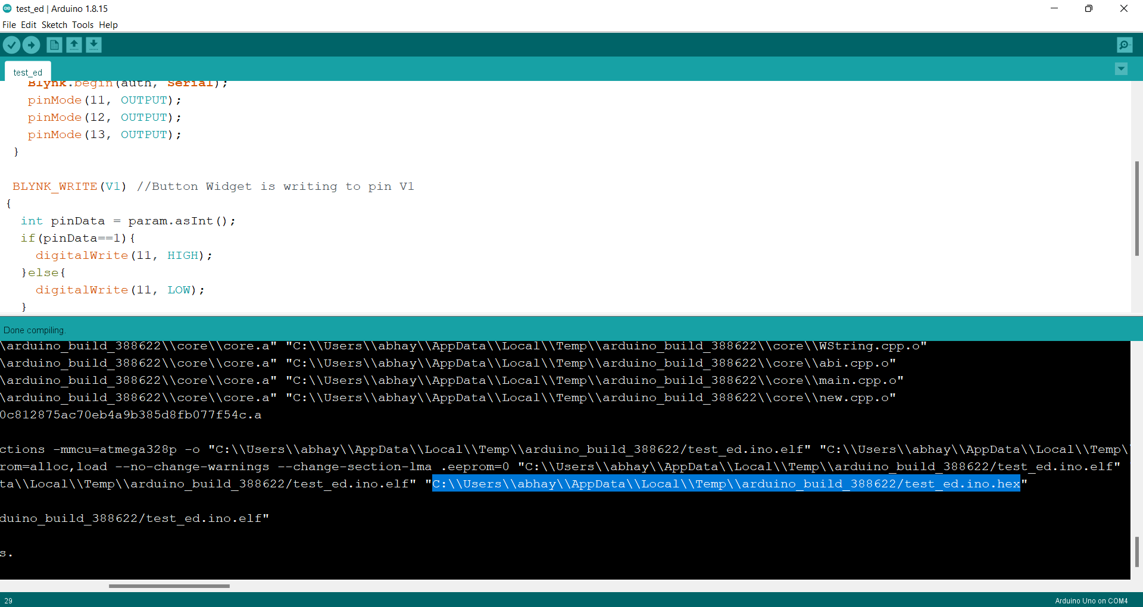
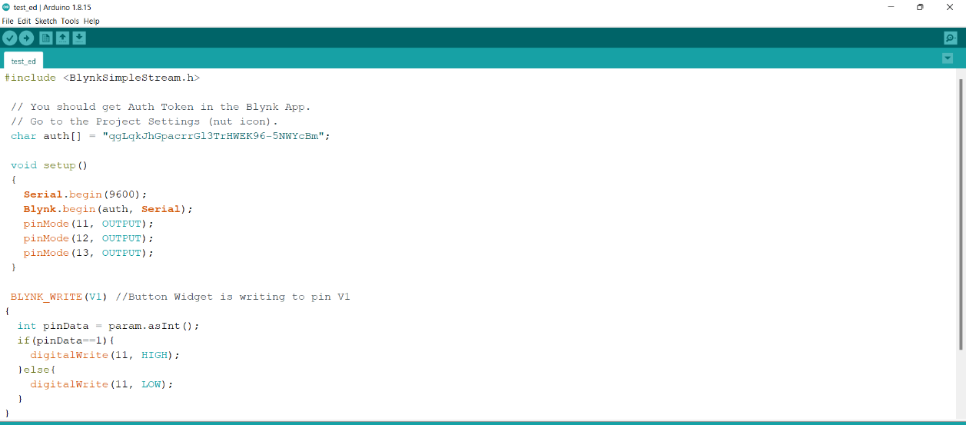
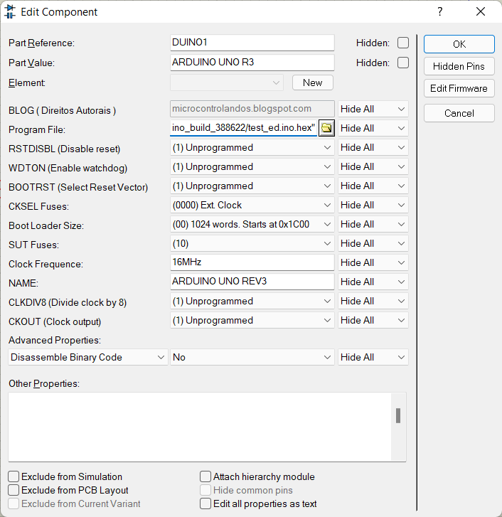
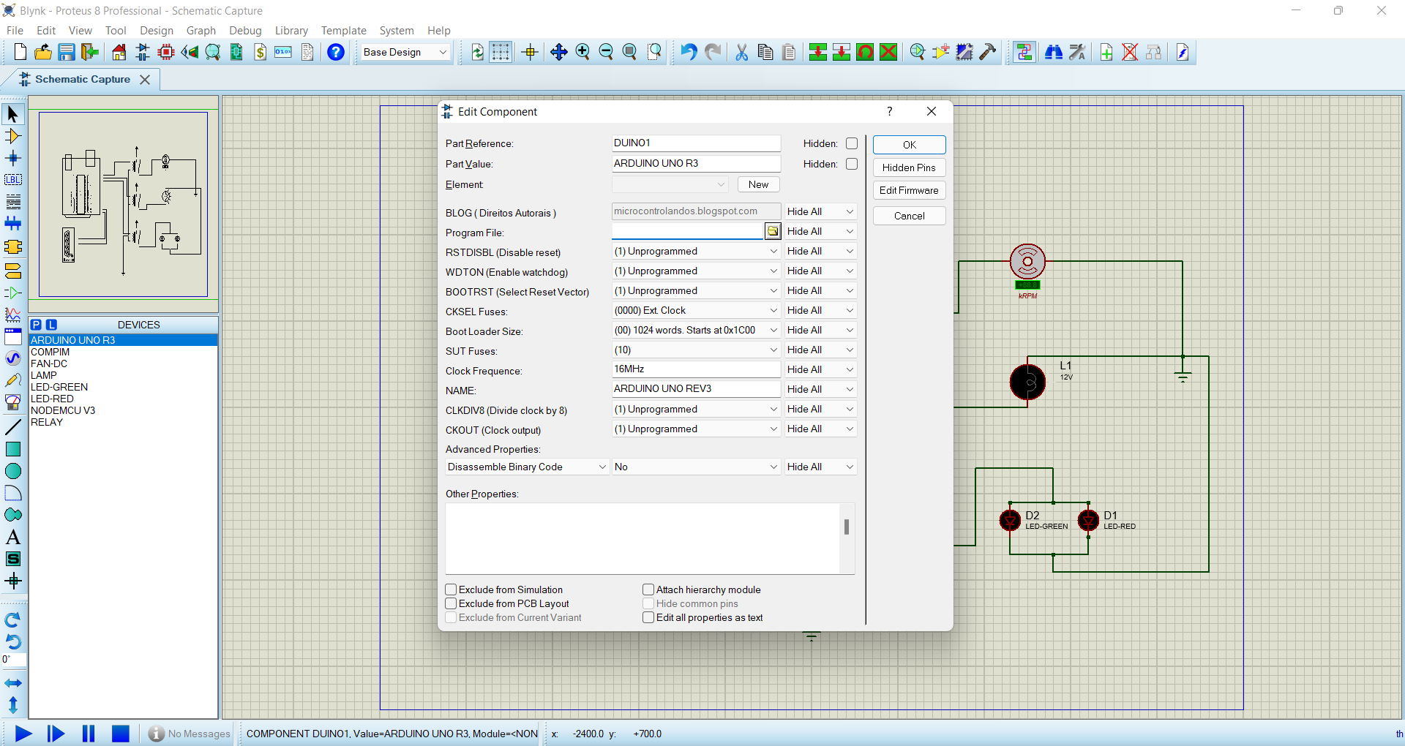

Slide 17
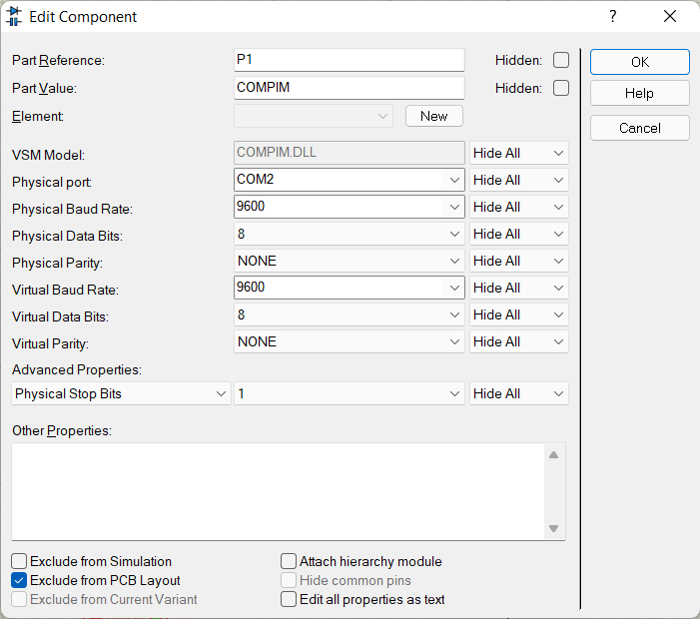
Set up Virtual Serial Port using COMPIM in Proteus
In Proteus, double clicking COMPIM we open a Edit Component window where we can select physical port and baud rate.

Slide 18
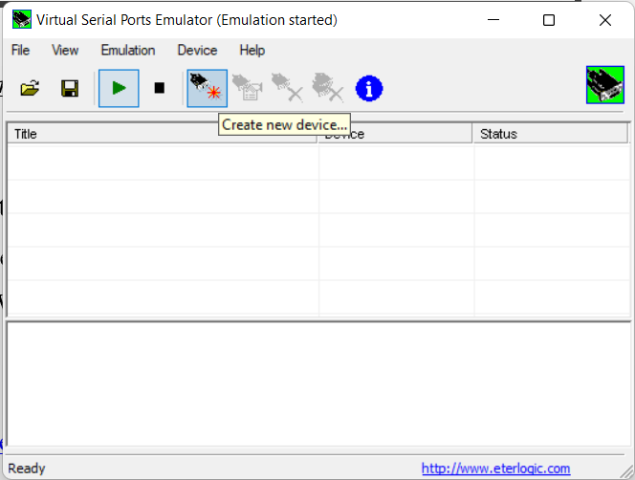
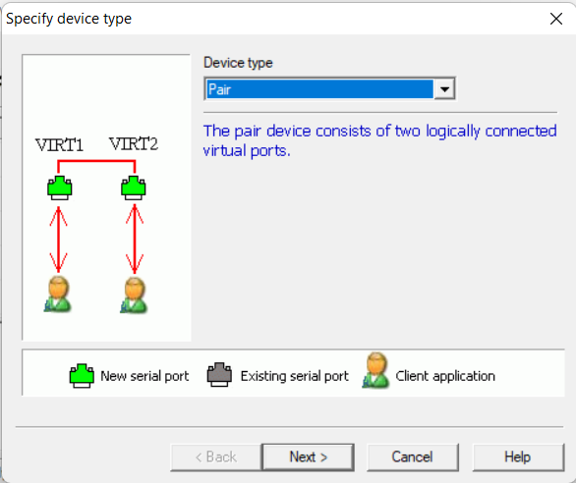
VSPE Set Up - 1
Create New Device and Select Pair from Drop down Menu
Open Application

Slide 19
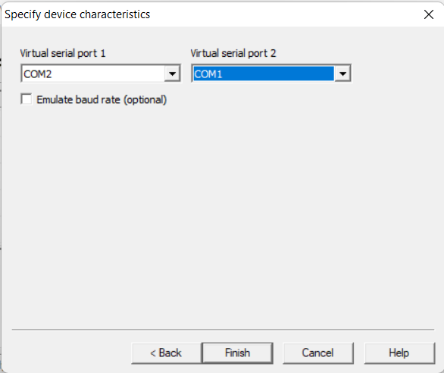
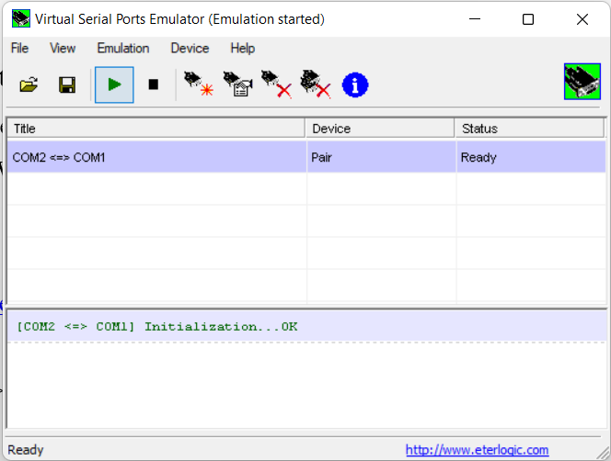
VSPE Set Up - 2
Successfully configured. Two ports now communicate with each other.
Connecting COM2 to COM1

Slide 20
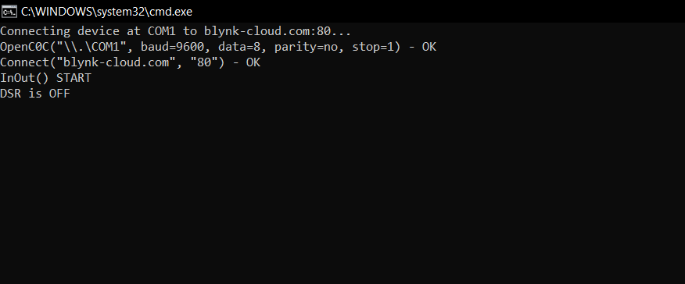
Blynk Library Script –
To receive data from Blynk
C:\Users\abhay\Documents\Arduino\libraries\Blynk\scripts and run blynk-ser.bat file.

Slide 21
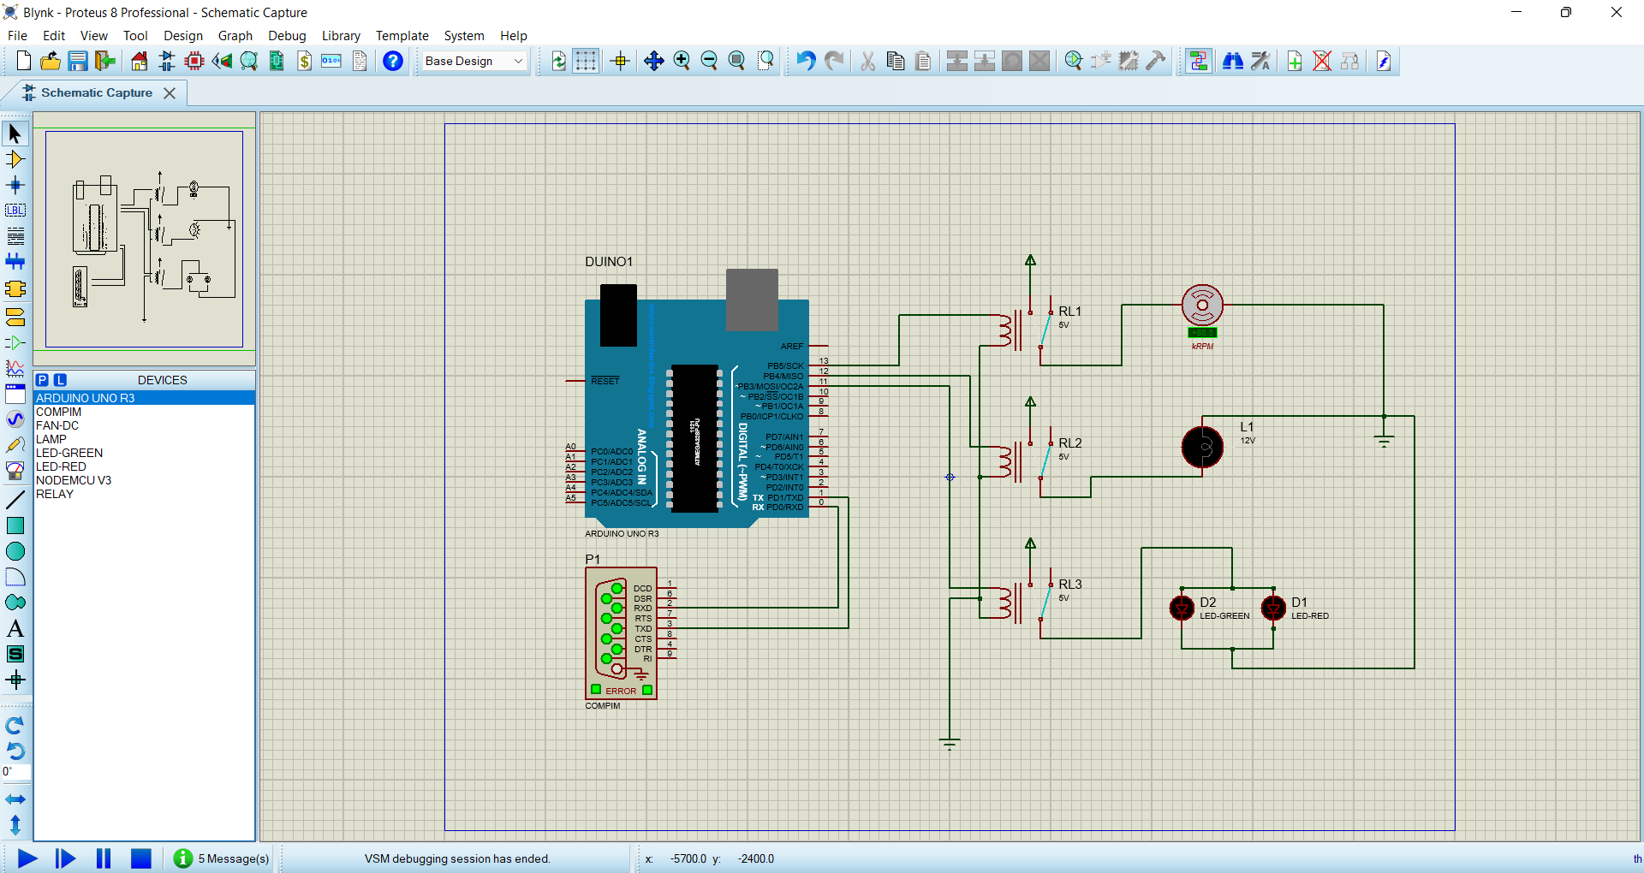
All Set Up – Turn to test using App
Control using Android App
Open Proteus and Start Simulation

Slide 22
Control Using Google Assistant
Platforms Used:
Adafruit
IFTTT

Slide 23
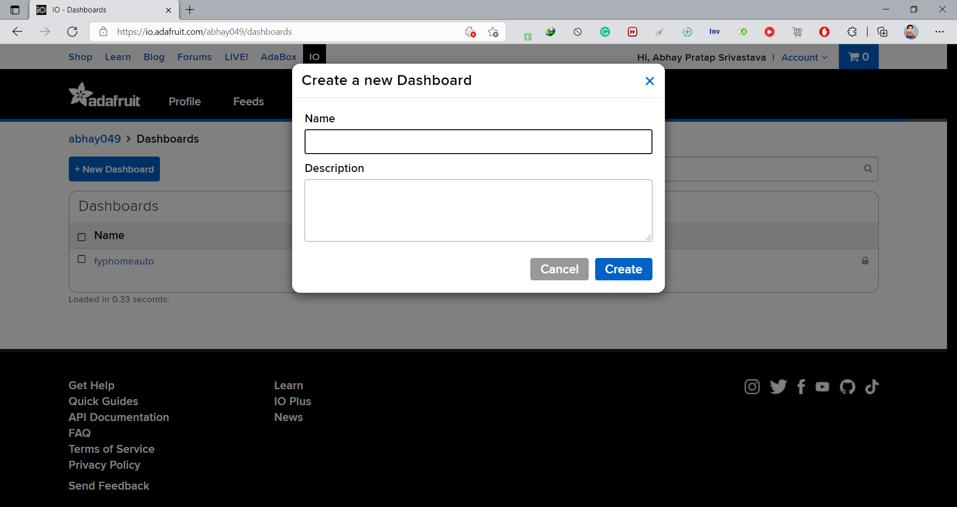
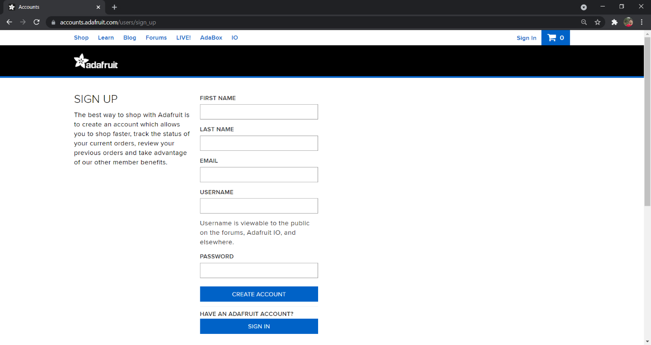
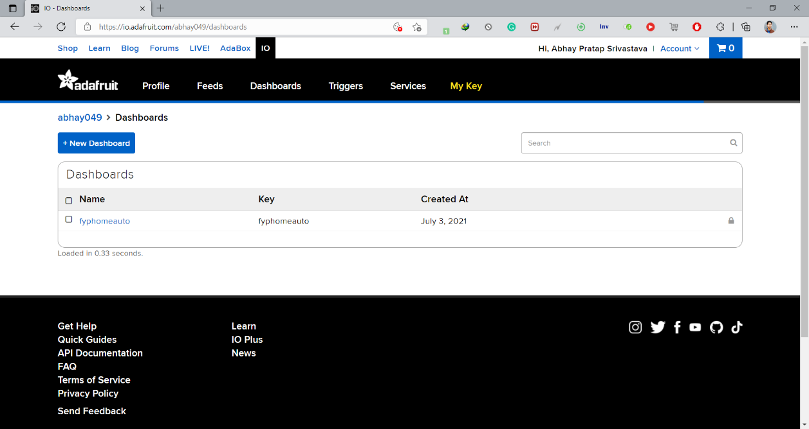
Adafruit.io Setup-1
2.Create Dashboard
1. Create Account Adafruit.io
fyphomeauto

Slide 24
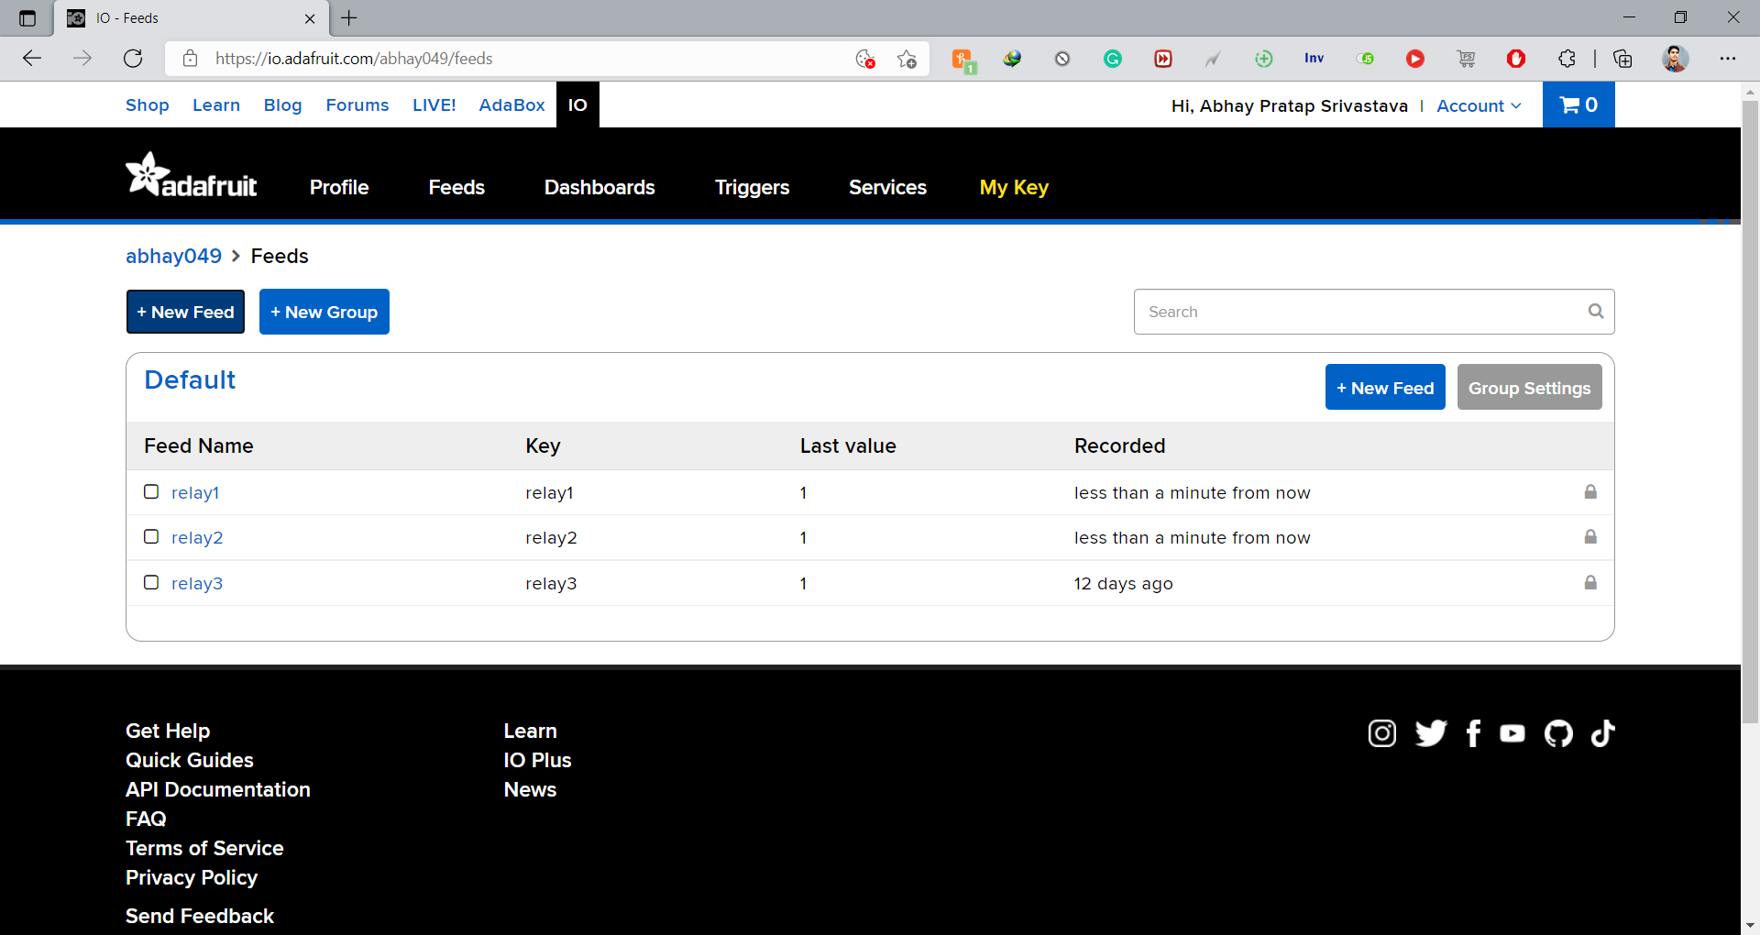
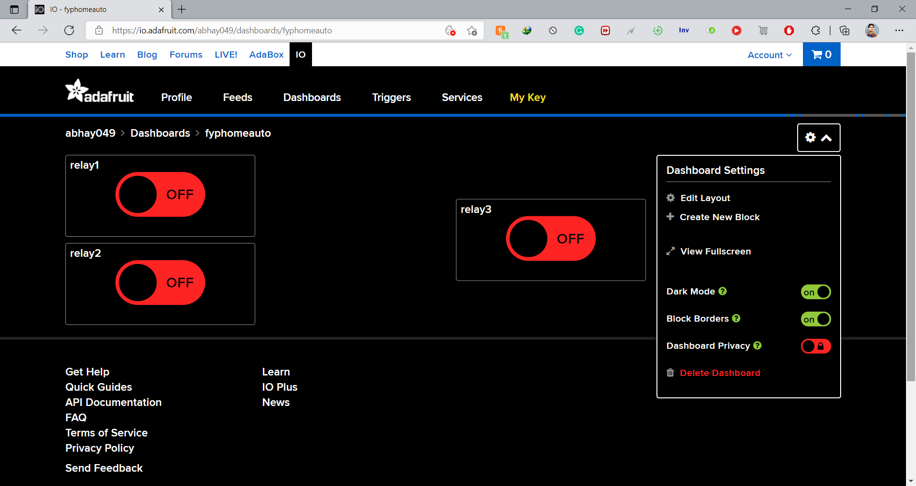
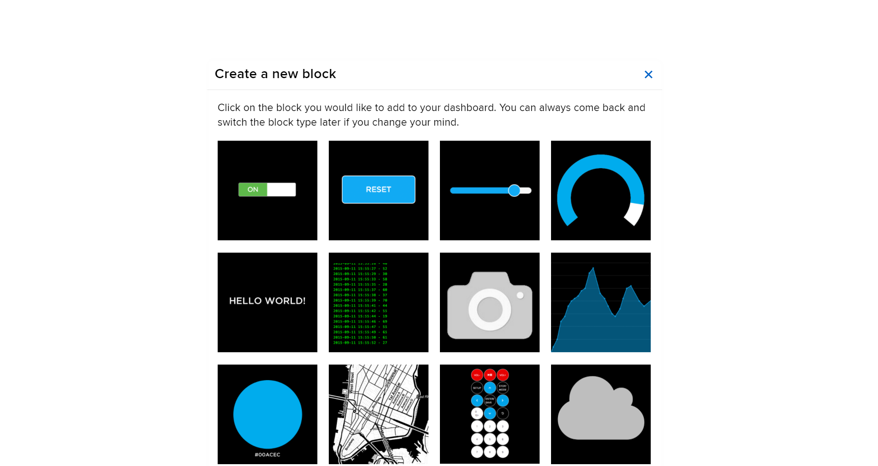
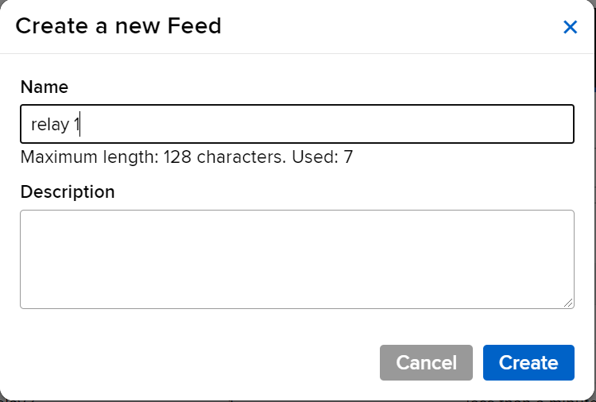
3. Create Feeds –
One Feed for one Relay
4. Create Blocks
Connect Feed to Toggle Button
Adafruit.io Setup -2

Slide 25
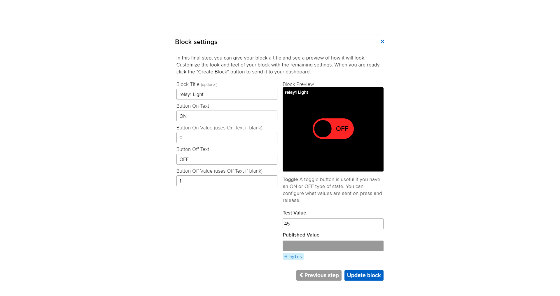
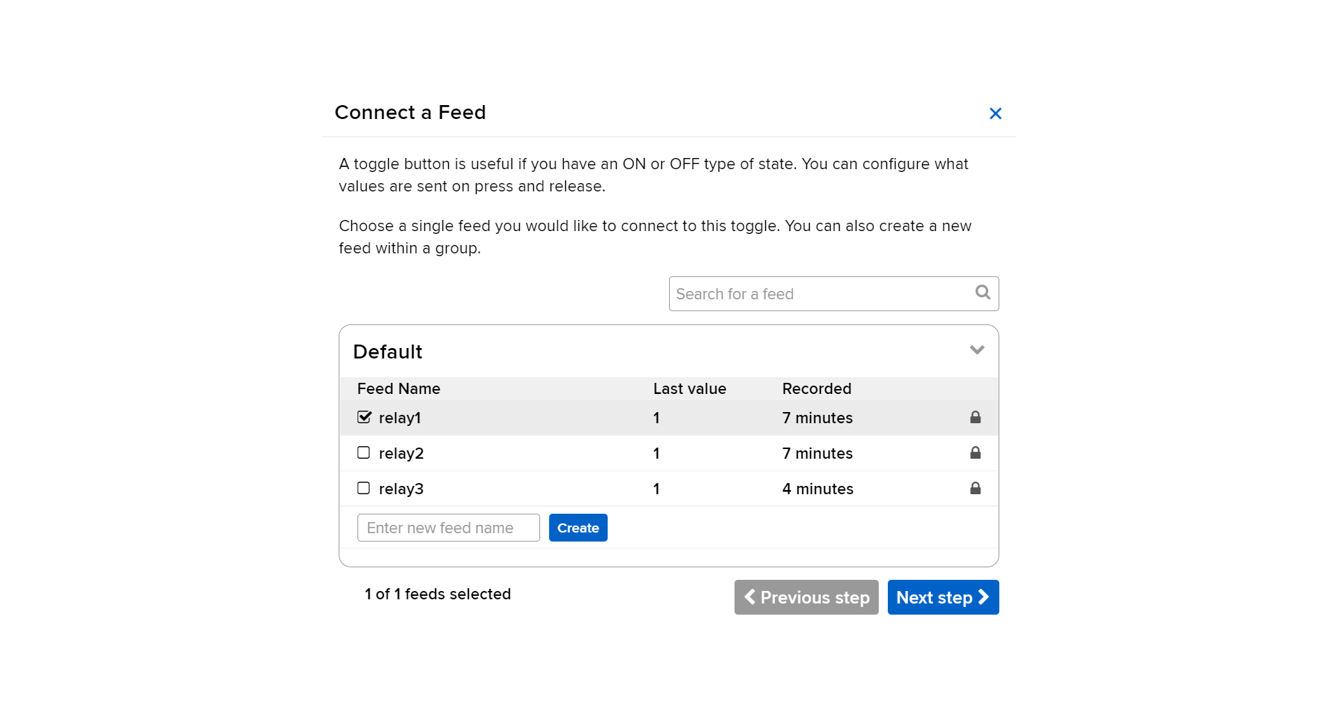
Adafruit.io Setup -3
6. Configure Button On & Off Value, Name and Text
5. Toggle Button for which relay,
select from list > Next Step

Slide 26
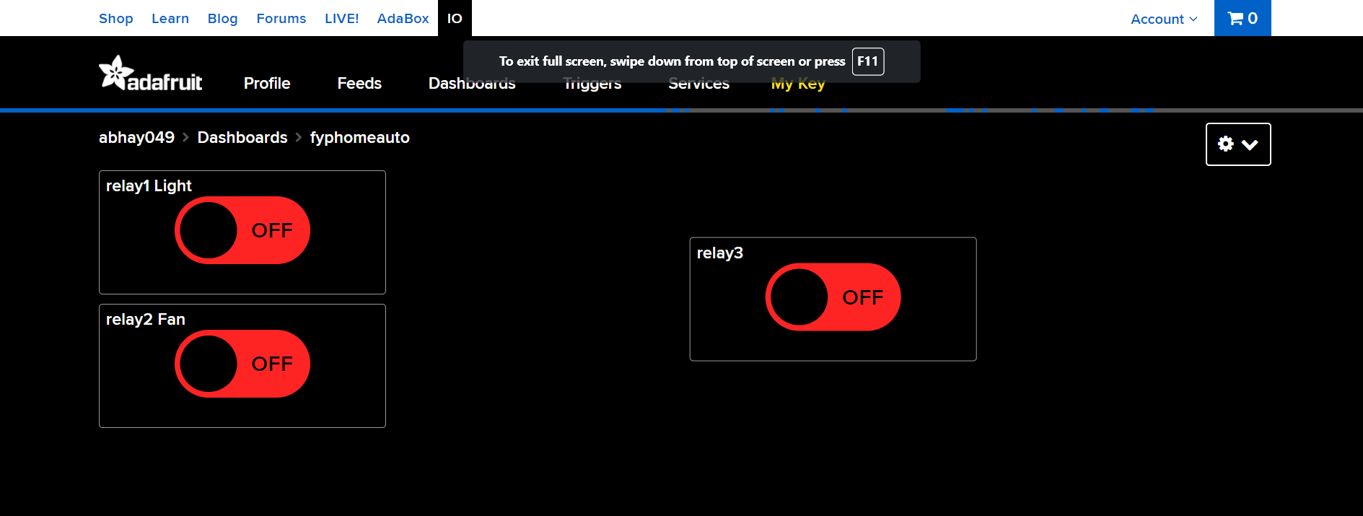
Adafruit.io Setup -4
7. After connecting all three feeds with Toggle Button

Slide 27


IFTTT-
IFTTT- If This Then That, also known as IFTTT, is a free web-based service to create chains of simple conditional statements, called applets.
Applet- An Applet connects two or more apps or devices together. It enables you to do something that those apps or devices couldn't do on their own.

Slide 28
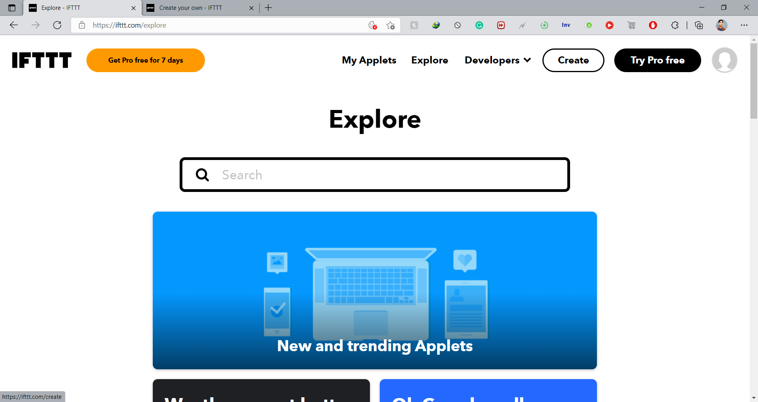
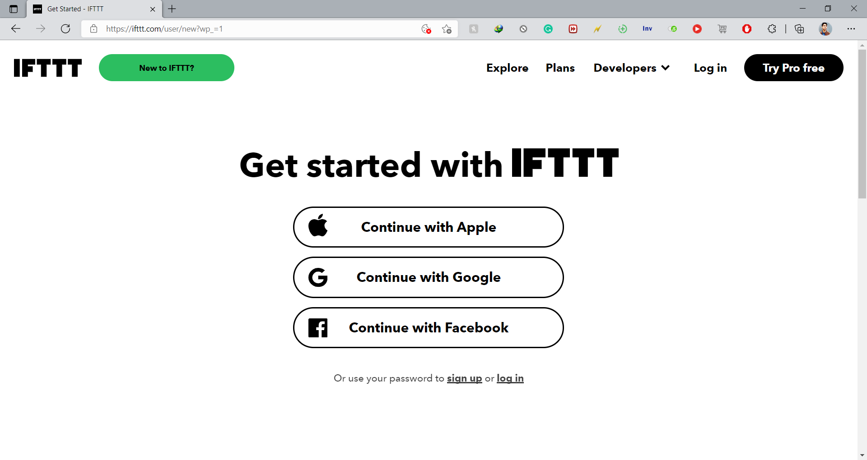
IFTTT Setup-1
2. Create Applet
1. Create account on IFTTT

Slide 29
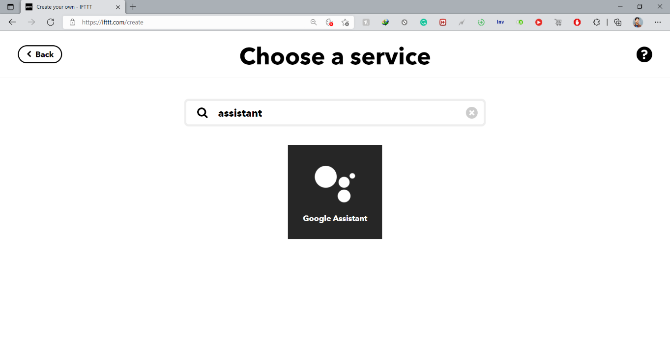
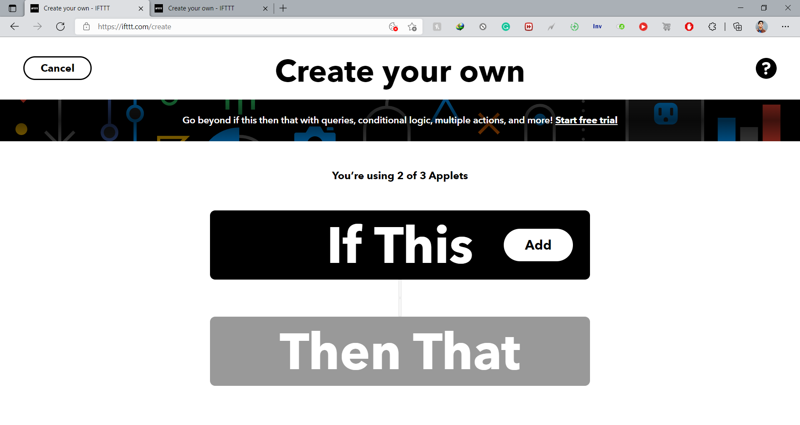
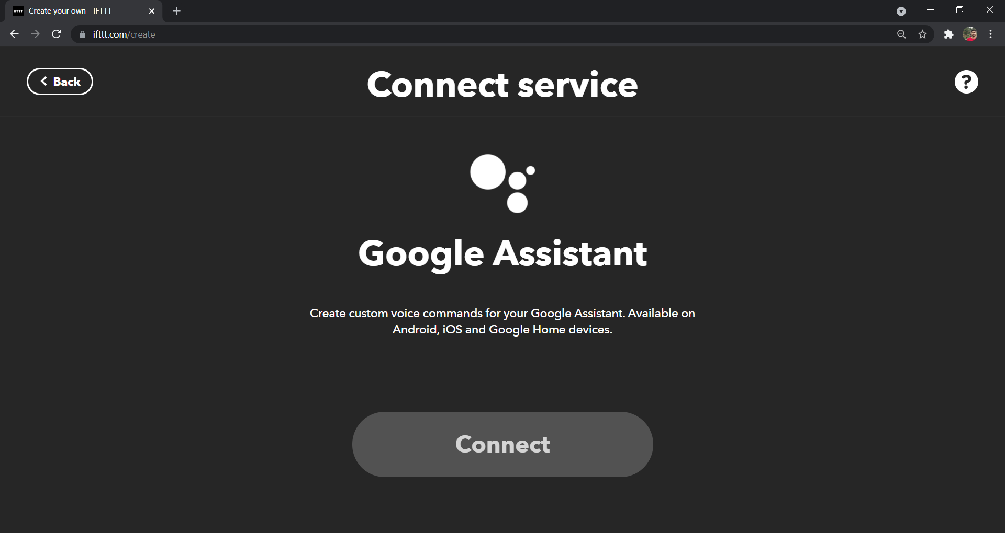
IFTTT Setup-2
4. Search and Connect Google Assistant
3. If This > Add Button > Google Assistant

Slide 30
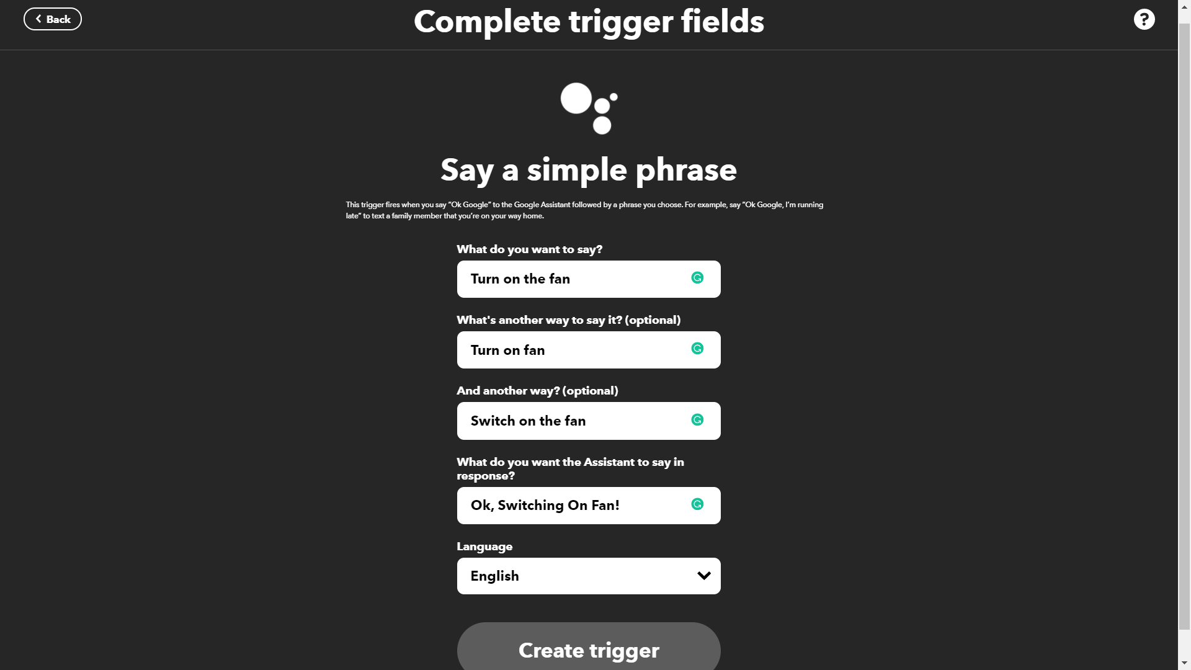
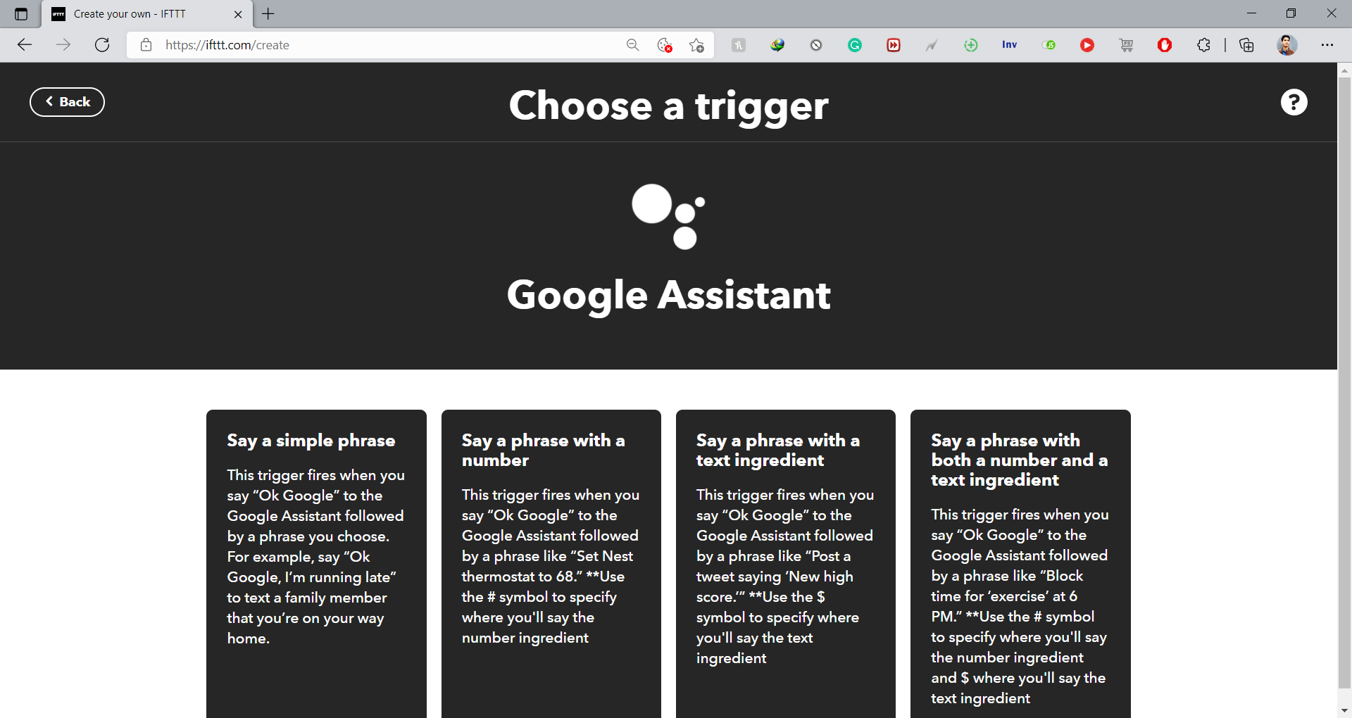
IFTTT Setup-3
6. Complete Trigger with Statements
5. Choose a Trigger > Simple Phrase

Slide 31
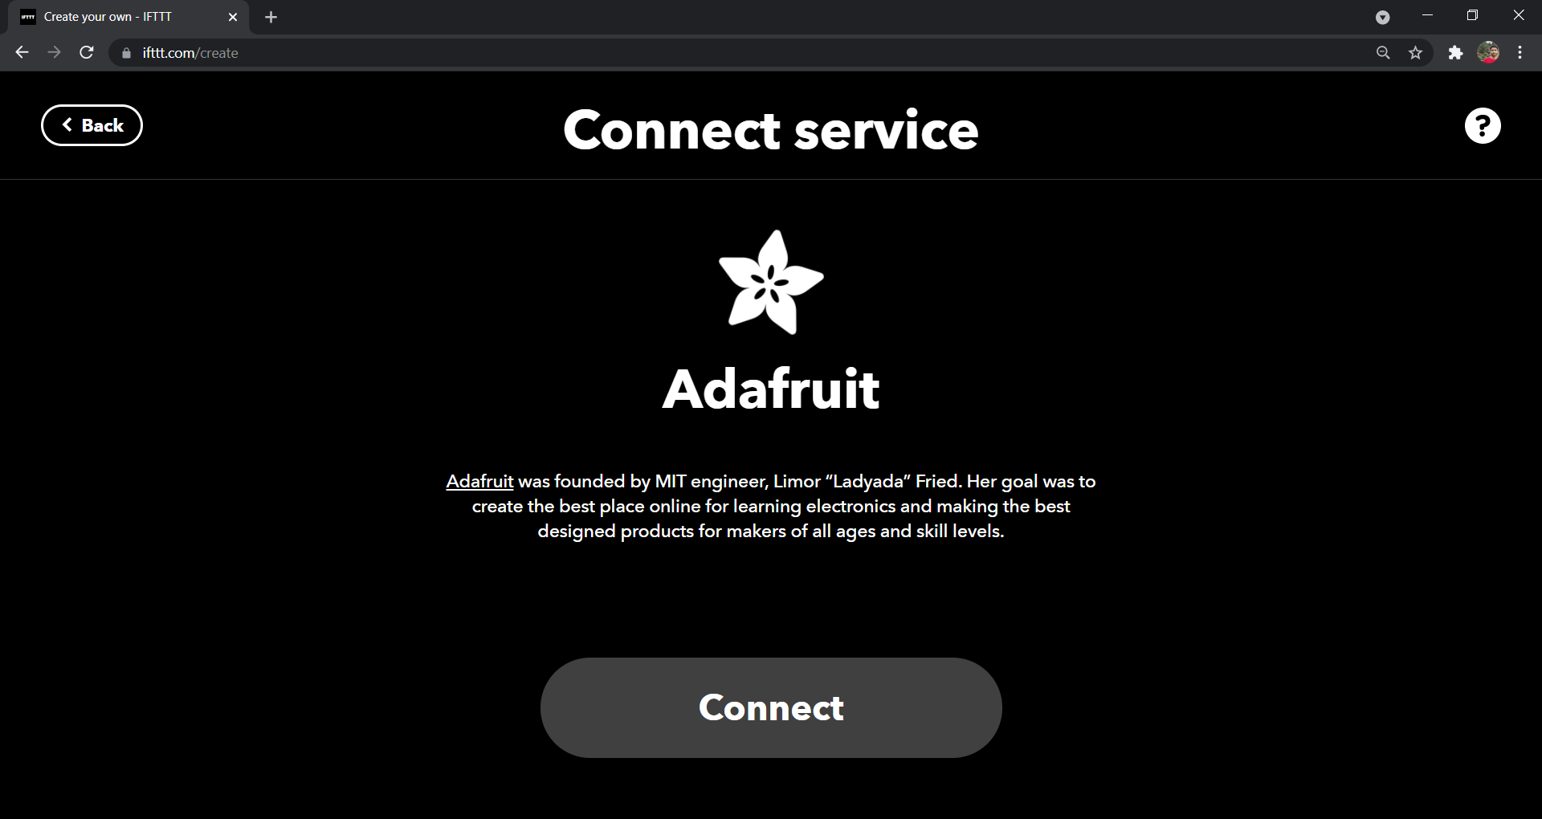
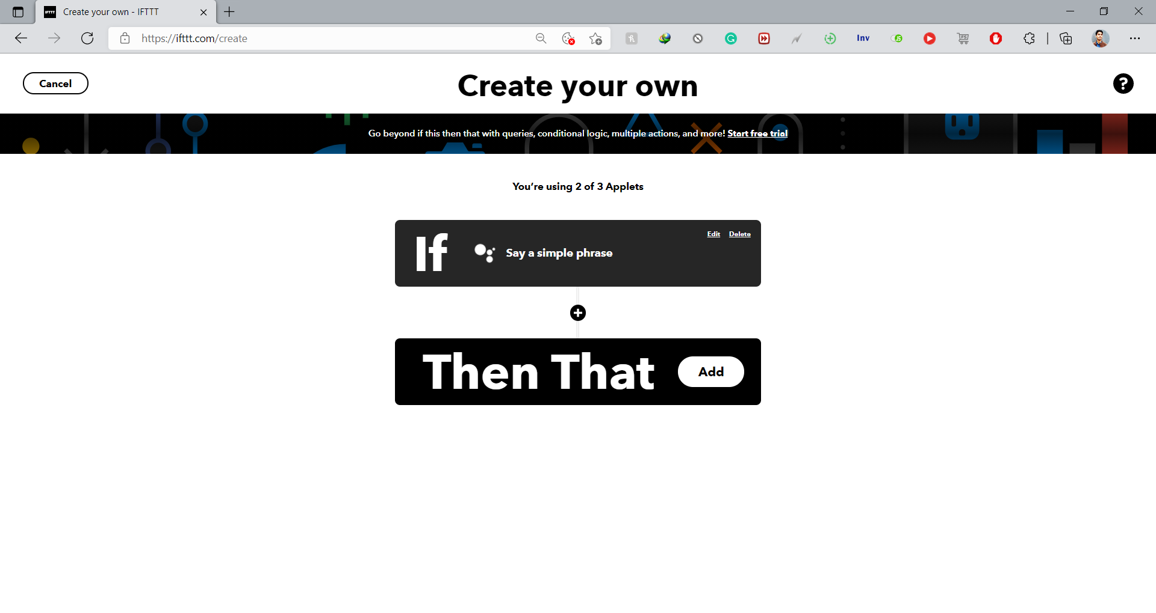
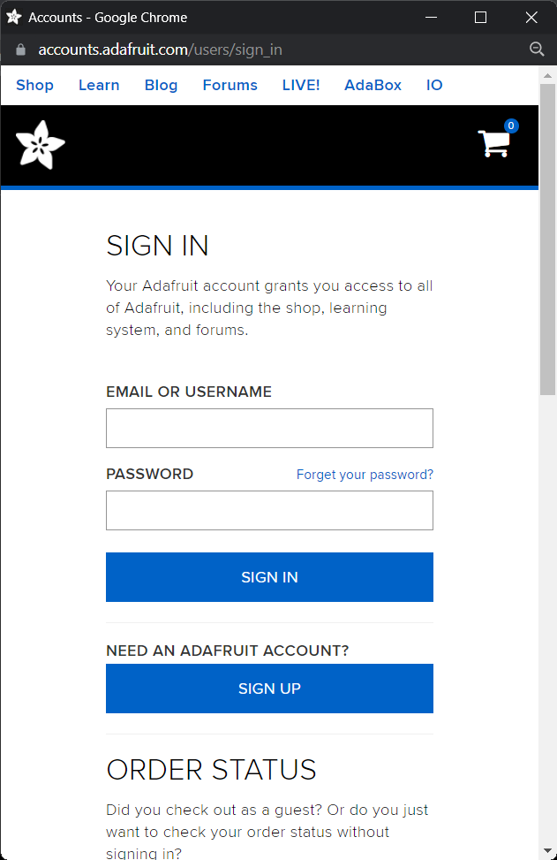
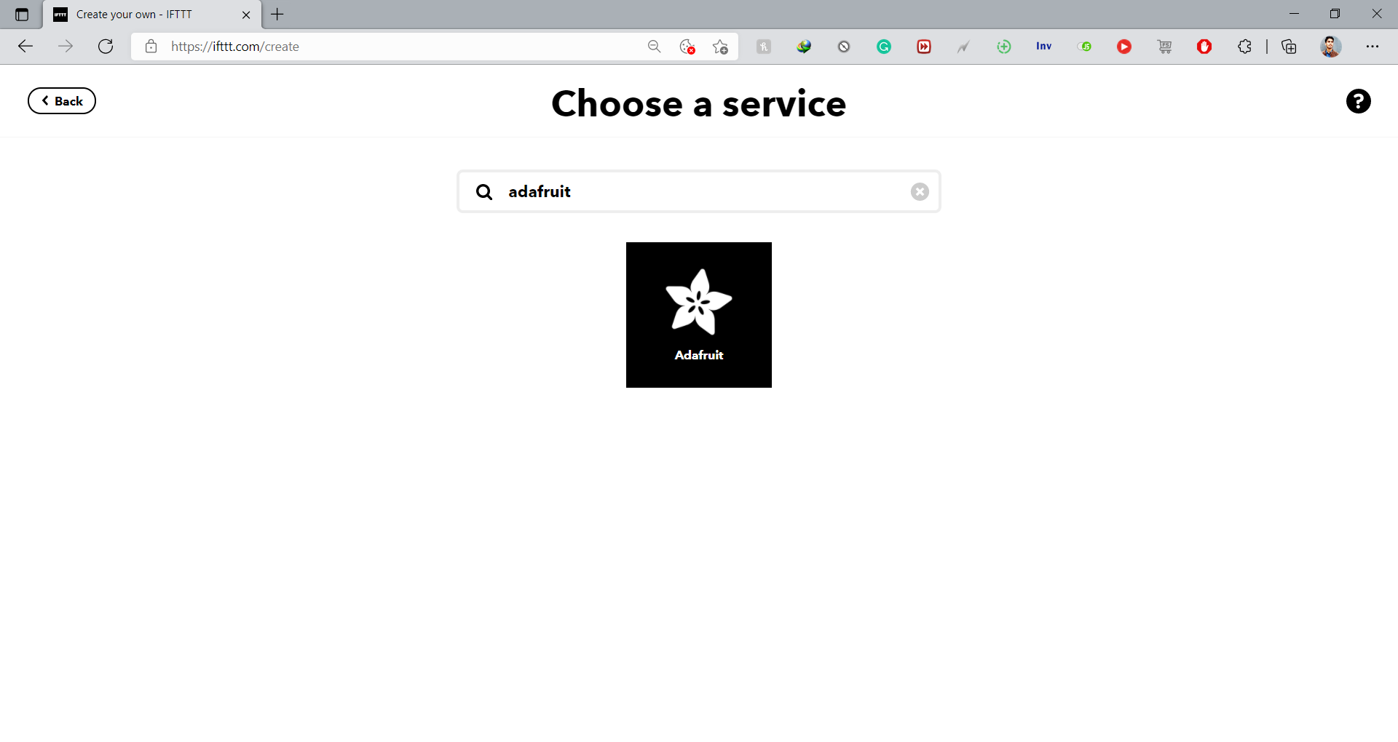
IFTTT Setup-4
9. Connect Adafruit
7. Then That > Adafruit
8. Search and Add Adafruit.io
10. Sign in Adafruit account.

Slide 32
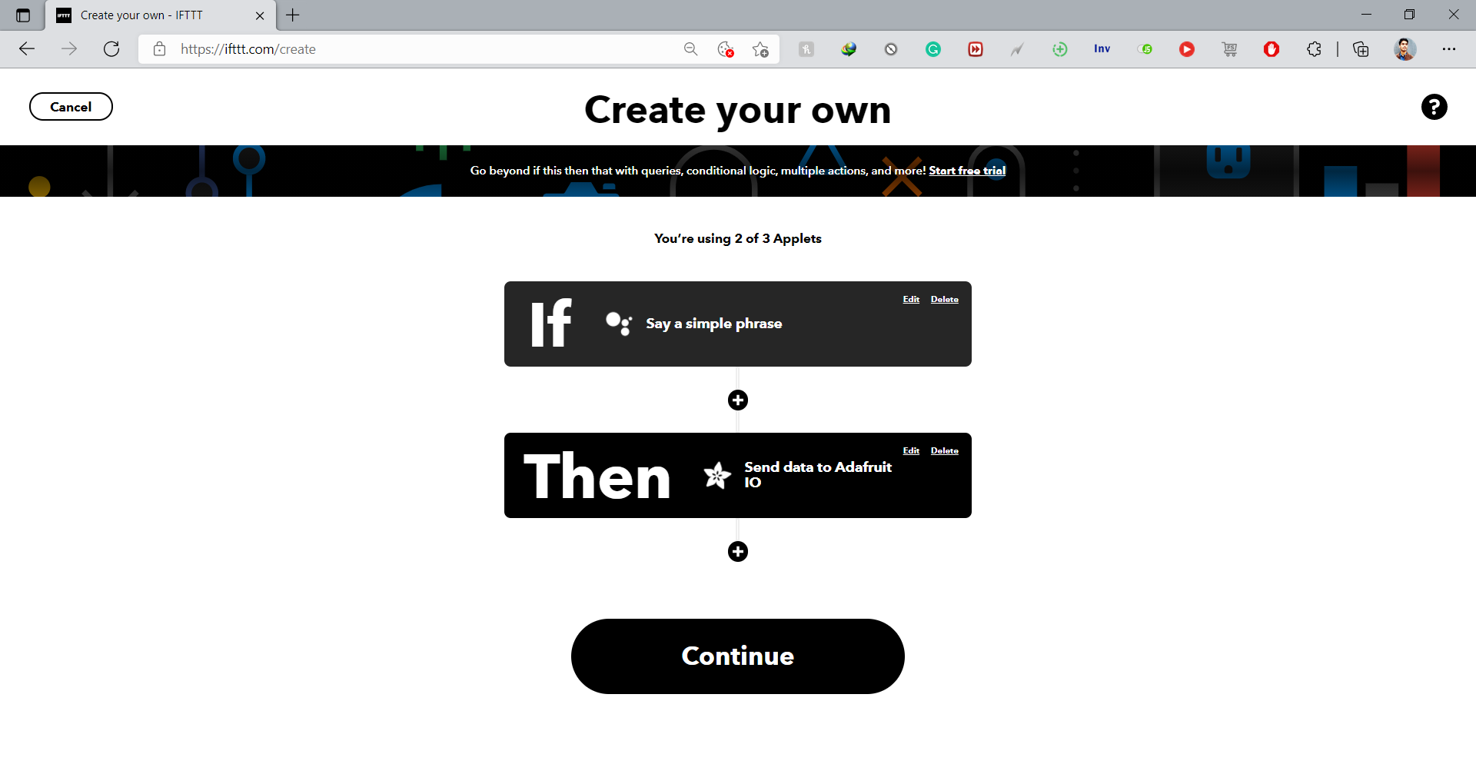
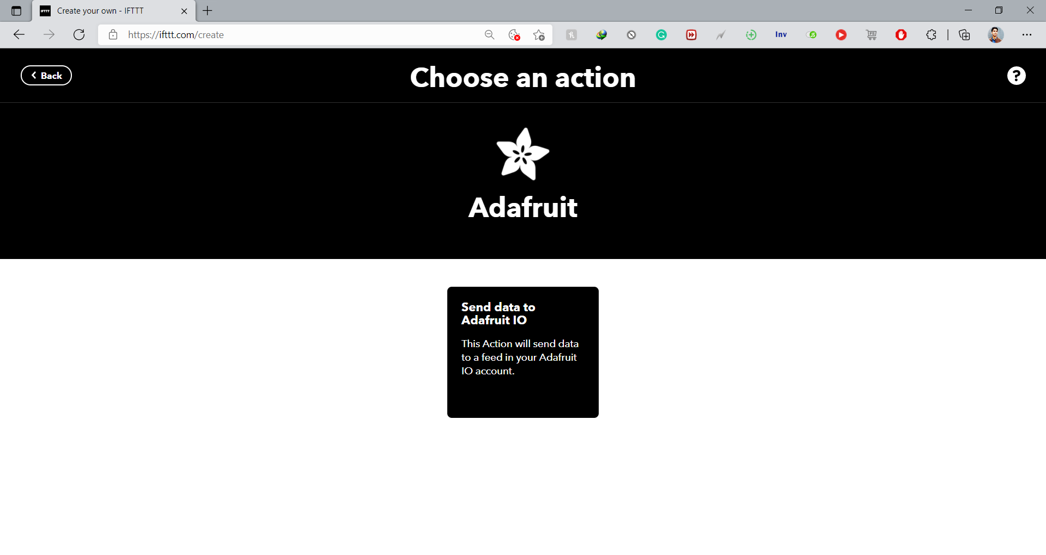
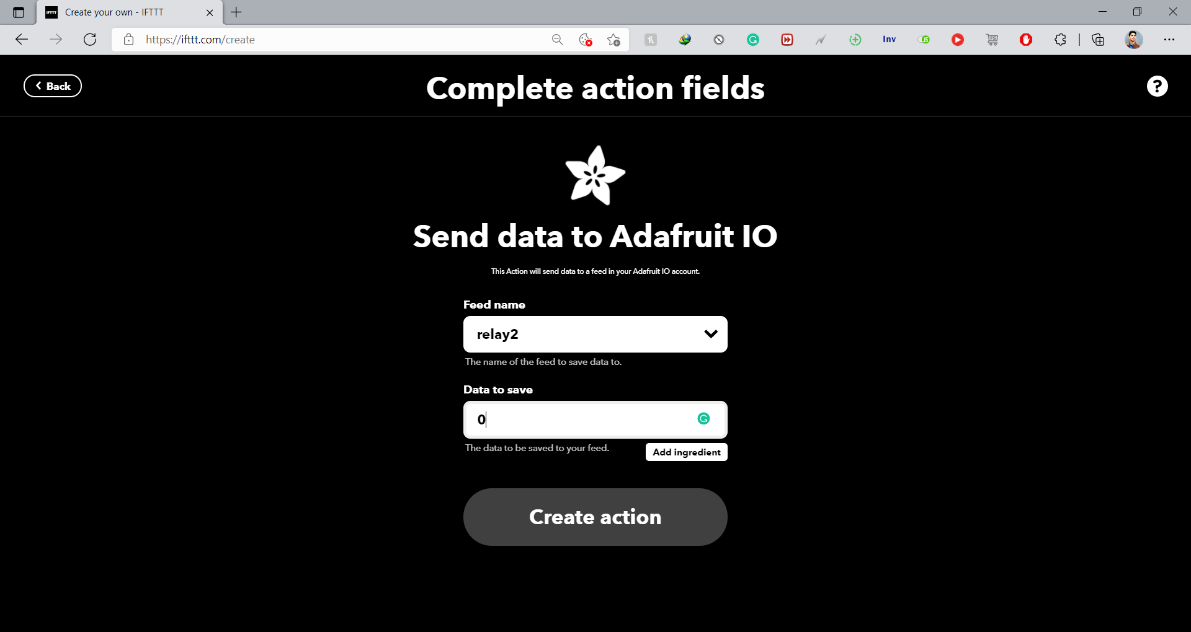
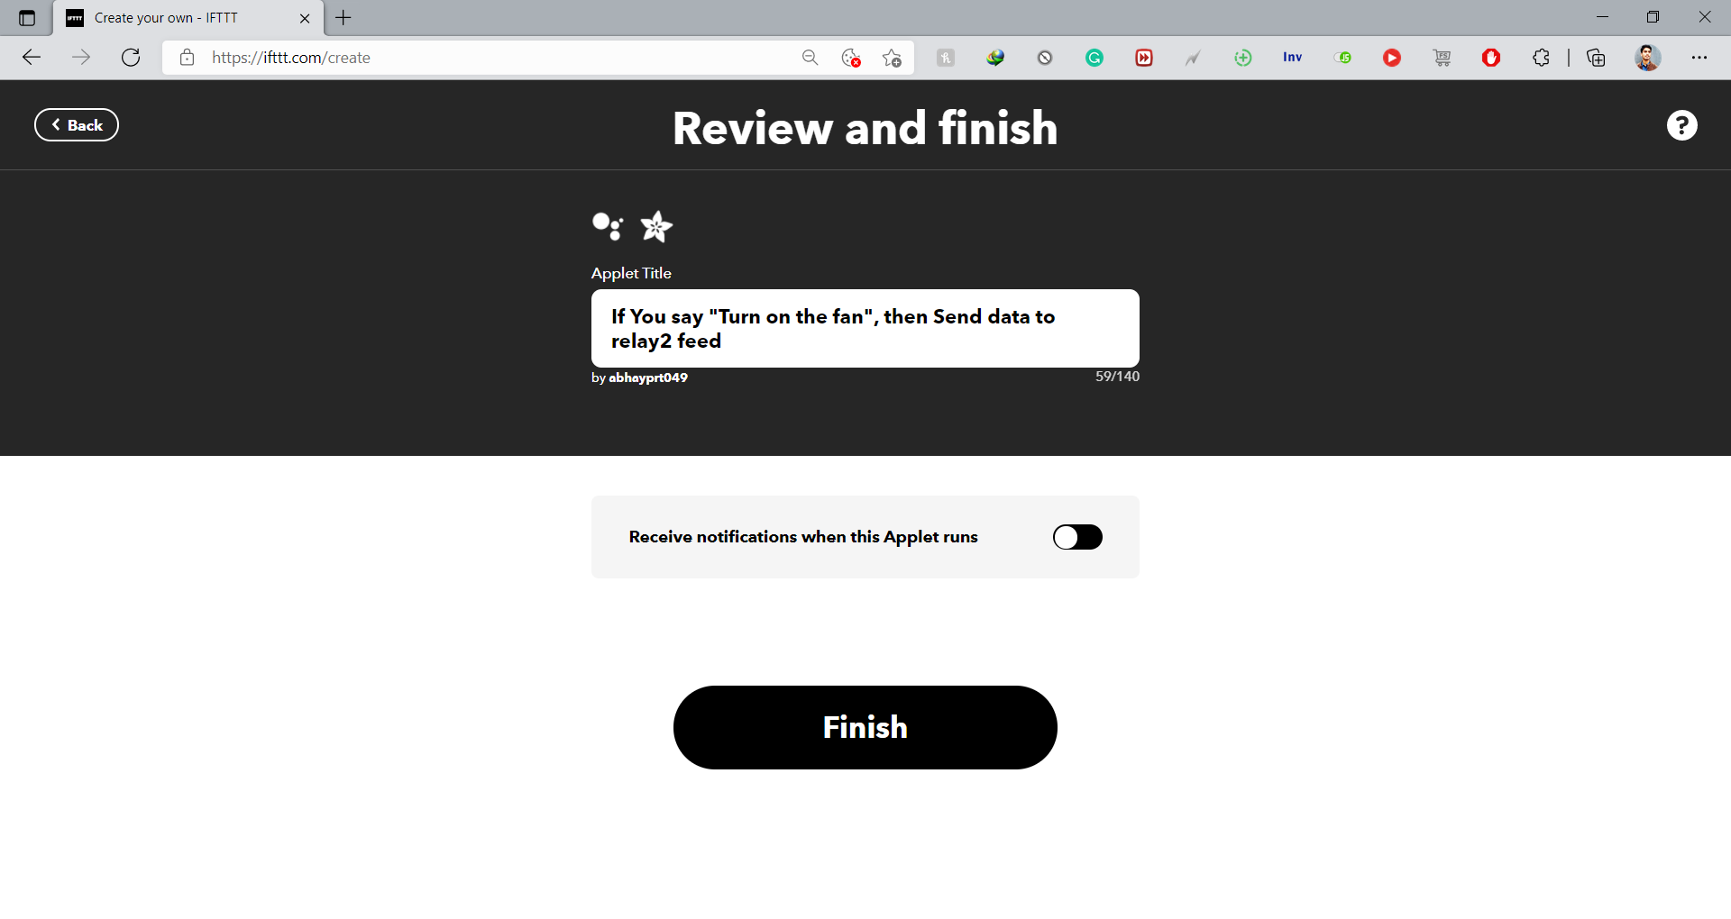
IFTTT Setup-5
13. Continue, Review and Finish
11. After Sign in Choose Send Data to Adafruit IO
12. Select Feed Name and Data to send
0 (ON) and 1 (OFF)

Slide 33


IFTTT Setup-6
14. Our Applet is Connected
15. Similarly, we can created maximum 3 applets

Slide 34


All Set Up – Turn to test using Google
Assistant

Slide 35

Conclusion
In this report, we have successfully done simulation of home automation system using Arduino UNO R3 and Internet of Things technology.
It has been experimentally proven to work satisfied by connecting sample appliances to it and the application were successfully controlled from a wireless android mobile device using app.
Also, with help of Google Assistant it can be controlled and its successful simulation is shown on Adafruit. The automated mode makes life easier for users by complete automation of necessary appliances without any human effort.

Slide 36
Reference
Home Automation Application Based On Arduino Controllable From Mobile by Anna Merino Herreros
Adafruit Documentation - https://io.adafruit.com/api/docs/ - adafruit-io-http-api
IFTTT Documentation- https://platform.ifttt.com/docs
Home automation – Wikipedia - https://en.wikipedia.org/wiki/Home_automation
Blynk Documentation- https://docs.blynk.cc
Pololu - Arduino Uno R3 - https://www.pololu.com/product/2191
VSPE- http://www.eterlogic.com/Products.VSPE.html

Slide 37

Thank You!

